Slide 1
District English Language Advisory Committee
DATE : October 16 2023
TIME: 5:30-7:30 PM

Slide 2
Big bold statement slide
Every system is perfectly designed to get the results it gets
SCUSD Core Value
We recognize that our system is inequitable by design and we vigilantly work to confront and interrupt inequities that exist to level the playing field and provide opportunities for everyone to learn, grow and reach their greatness.
SCUSD GUIDING PRINCIPLE
All students are given
an equal opportunity to graduate with the greatest number of postsecondary choices
from the widest array of options

Slide 3
SCUSD Five Strategic Priorities
High Quality Instruction to Meet the Needs of all Students with a Focus on Students Least Well Served
Multi-Tiered System of Supports (MTSS)
Culturally Responsive Professional Learning
Effective Talent Programs Focused on Recruitment & Retention in Service of High Quality Instruction
Network Upgrades and Centralized Workforce Processes; Including HR Enhancements in Service of High Quality Instruction

Slide 4
Multilingual Literacy Department Outcomes
All emergent bilingual students improve on their overall Summative ELPAC Assessments by at least one performance level.
All emergent bilingual students improve on their CAASPP ELA assessments noted by the student’s scale score (3-8th CAASPP, 11th CAASPP);iReady ELA
Increase reclassification by 10% on a yearly basis.
90% of EBs will graduate from high school.
80% of High School Emergent bilingual students will be on track for college and career (students meeting A-G requirements).
All schools serving at least 21 or more emergent bilingual students will have a functional English Language Advisory Committee (ELAC).

Slide 5
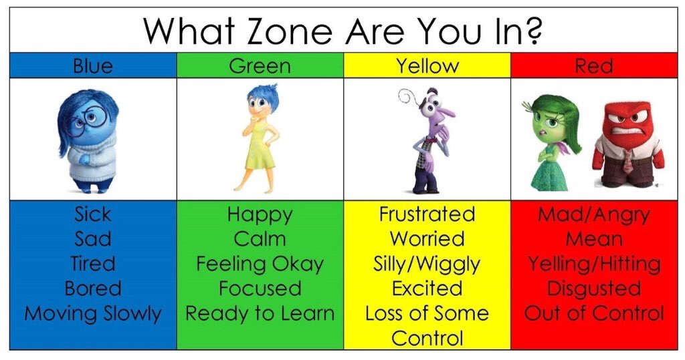
COMMUNITY CONNECTOR: How are you feeling today?
I feel…

Slide 6
DELAC REPRESENTATIVE ROLL CALL

Slide 7
APPROVAL OF MEETING MINUTES
May 17, 2023 Meeting Minutes (English)

Slide 8
AGENDA
5:30-5:35 p.m. | Welcoming and introduction of MLD Team and DELAC representatives | Dr. Simms
5:35-5:45 p.m. | DELAC Roll Call | Patricia/Jo
5:45-5:50 p.m. | Review of the agenda | Dr. Krbecek
5:50-6:20 p.m. | CON APP Presentation | Dr. Odipo, State and Federal
6:20-6:30 p.m. | BREAK
6:30-7:00 p.m. | Reports: Title III Addendum Needs Assessment DELAC Officer Nominations Robert's Rules of Order EL Data At-A-Glance | Dr. Simms/Dr. Krbecek

Slide 9
Agenda
7:00-7:15 p.m. | Public Comment | DELAC Membership
7:15-7:30 p.m | DELAC Feedback Meeting Closure | Dr. Simms

Slide 10
CON APP

Slide 11
Federal Program Funding to Improve Student Outcomes
Consolidated Application Spring Report
District English Learner Advisory Council (DELAC) Meeting

Slide 12
What is the Consolidated Application (ConApp)?
The Consolidated Application is a document used to apply to the California Department of Education to receive federal funds.
When the district applies for federal funding, they are assuring or promising to follow the rules and regulations for using the funds.

Slide 13
The Application for Funding
SCUSD is requesting the following funds from CDE:
Title I Part A
Title II Part A
Title III English Learner
Title IV Student Support and Academic Enrichment

Slide 14
Title I Assurances
Ensure that all children receive a high-quality education, and close the achievement gap between the children who are meeting the challenging State academic standards and those children who are not.
Each funded school has a school plan that has a “needs assessment” that identifies the specific needs of the students.

Slide 15
Title I : Assurances (cont.)
Address the needs of all children in the school, but particularly the needs of those at risk of not meeting the State academic standards
Provide activities which may include counseling, school-based mental health programs, specialized instructional support services, mentoring services, and other strategies to improve students’ skills outside the academic subject areas.

Slide 16
Title I : Assurances (cont.)
Provide assistance to parents of children served by the Title I funded school, in understanding such topics as the State academic standards, state and local academic assessments, and how to monitor a child’s progress and work with educators to improve the achievement of their children.

Slide 17
How are Title I Part A Funds Used –
Examples of Expenditures
Title I Part A: District (LCAP Addendum)
Equitable services to Private Schools; Training Specialists; ELA and Math Support; Priority Schools; Student Support and Health Services; Parent Resource Center, After school programs
Title I Part A: School Sites – (SPSA)
Intervention; Instructional Coordinators; Resource Teachers, Instructional Aides, Supplemental materials; Assessment & Intervention programs; Parent Resource Centers

Slide 18
Title II – Supporting Effective Instruction- Assurances
The district will identify and address any inequalities that result in low-income students and minority students being taught at higher rates than other students by ineffective, inexperienced, or out-of-field teachers.
The district must provide plans for use of Title II funds to improve teacher and principal quality.

Slide 19
BREAK: 10 Minutes
19

Slide 21
NEEDS ASSESSMENT

Slide 22
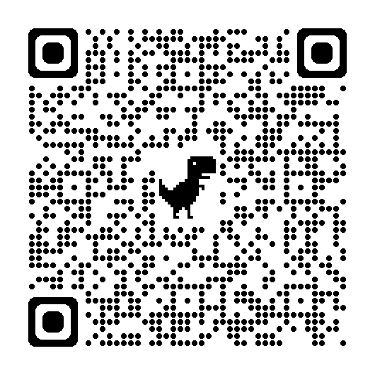
Needs Assessment Survey 2023-2024
Please choose 5 topics you would like to have in our next DELAC Meeting.

Slide 23
OFFICER NOMINATIONS

Slide 24
Officer Nominations
DISTRICT ENGLISH LEARNER ADVISORY COMMITTEE (DELAC)
RESPONSIBILITIES/DUTIES OF THE DELAC
Advice and assistance in developing a district master plan for educational programs and services for ELs considering the Single Plan for Student Achievement. (5 CCR 11308[c][1])
Advice and assistance in conducting a district-wide needs assessment on a school-by-school basis. (5 CCR 11308[c][2]).
Advice and assistance in establishing district programs, goals, and objectives for programs and services for ELs. (5 CCR 11308[c][3])
Advice and assistance in developing a plan to ensure compliance with applicable teacher and instructional aide requirements. (5 CCR 11308[c][4]).
Advice and assistance in reviewing and commenting on the California Department of Education Reports. (5 CCR 11308[c][5])
Advice and assistance in reviewing the District’s reclassification procedures, (5 CCR 11308[c][6])
Advice and assistance in reviewing the written notifications for parents and guardians. (5 CCR 11308[c][7])

Slide 25
EL Data At A Glance

Slide 26
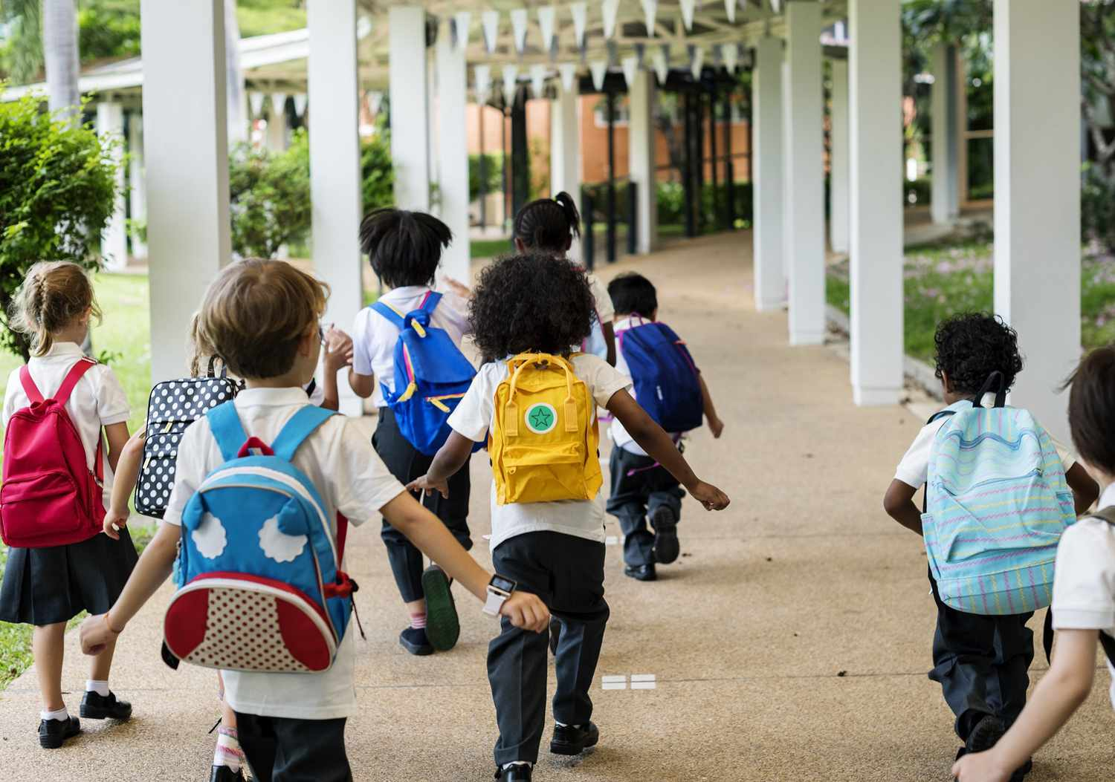

Slide 27
At-A-Glance ELPAC 2023
 | ELPAC Overall Level
Grade | Level 1 |  | 2 |  | 3 |  | 4 |  | (blank) Only portion of test were completed |  | Grand Total
District Total # EL Students | 2304 | 31% | 2185 | 29% | 2034 | 27% | 922 | 12% | 8 | 0% | 7453

Slide 28
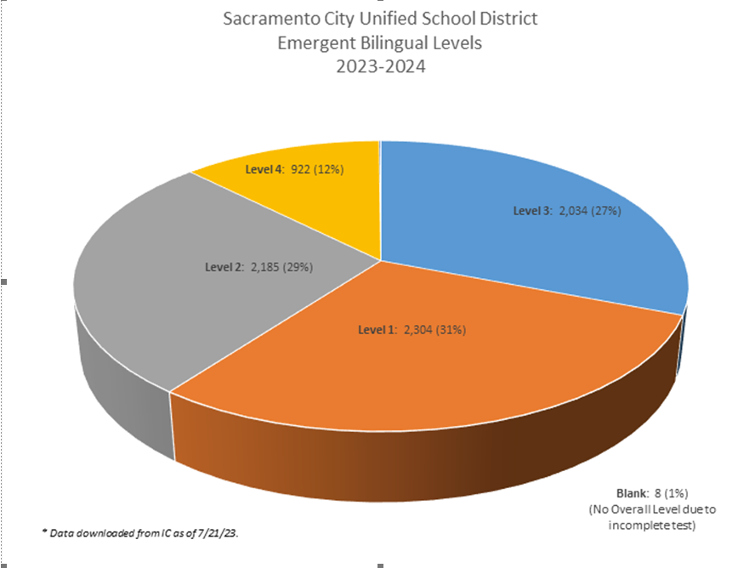
At-A-Glance ELPAC 2023

Slide 29
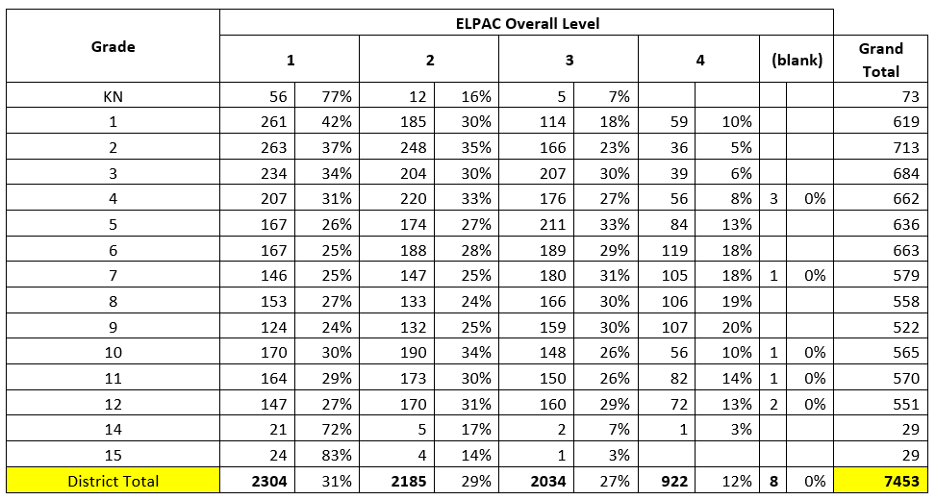
At-A-Glance ELPAC 2023

Slide 30
PUBLIC COMMENT

Slide 31
Public Comment
DELAC PUBLIC COMMENT

Slide 32
Notes:
We will continue to work on communication skills

Slide 33
DELAC FEEDBACK

Slide 34
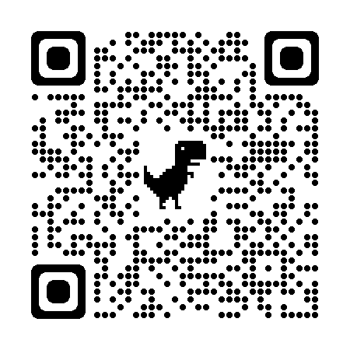
DELAC Feedback QR CODE
DELAC FEEDBACK LINK

Slide 35
Big quote
:La educación es el arma mas poderosa que puedes usar para cambiar el mundo.
–Nelson Mandela

Slide 36
Community Closing Activity

Slide 37
Upcoming Meetings:
DELAC
Monday, December 18, 5:30-7:30 p.m.
Monday, February 5, 5:30-7:30 p.m.
Monday, March 18, 5:30-7:30 p.m.
Monday, April 15, 5:30-7:30 p.m.
MPAC
Monday, October 23rd, 6:00 p.m. - 7:30 p.m. ( through zoom)
Monday , December 11th, 6:00 p.m. - 7:30 p.m. ( through zoom)
Monday , February 23th , 6:00 p.m. - 7:30 p.m.
Monday , March 25 th , 6:00 p.m. - 7:30 p.m.
Monday, April 22nd, 6:00 p.m. - 7:30 p.m.
SCUSD BOARD MEETINGS
Thursday, October 19, 6:30 p.m.
Thursday, November 2, 6:30 p.m.

